Slide 1

OLABISI ONABANJO UNIVERSITY FACULTY OF PHARMACY SAGAMU CAMPUS
Pcl 302 (Pharmacotherapeutics) By
Dr Uchenna IH Eze
Dr TO Fajemirokun
Dr Ajibade S. Saka
Dr Winifred A Ojieabu

Slide 2
1.AntiParkisonian and related Drugs
2. Hypono Sedative Drugs
By
Dr Uchenna IH Eze

Slide 3
Antiparkinsonian and related Drugs

Slide 4
Definition :
Parkinsonism is a progressive neurological disorder of muscle movement as a clinical syndrome consisting of 4 cardinal features:
1) resting tremor (which usually disappears during voluntary movement)
2)muscular rigidity
3)bradykinesia (slowness of movement) and, in extreme cases, a loss of physical movement (akinesia)
4)impairment of postural balance leading to disturbances of gait and falling

Slide 5
Secondary manifestations
mask-like face,
difficulty in speech,
slowing of mental process and
dementia

Slide 6
Parkinsonism (PD) - signs

Slide 7
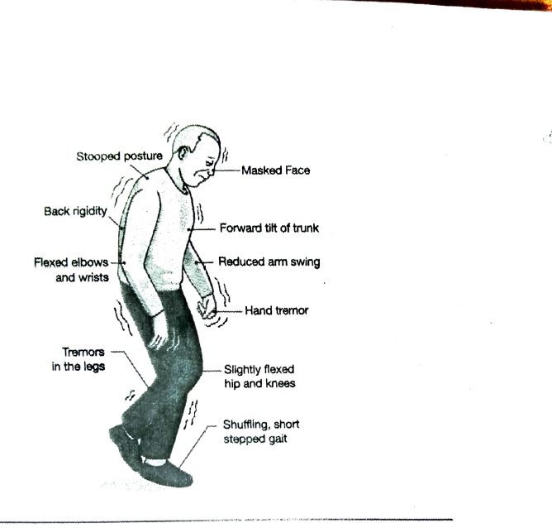

Slide 8
Main Pathological feature of Parkinson’s disease=
The loss of the dopaminergic nigrostriatal pathway.
Dopaminergic neurons in the substantia nigra that normally inhibit the output of GABAergic cells in the striatum are lost
80% of the Dopamine producing cells must be lost before symptoms begin to show

Slide 9
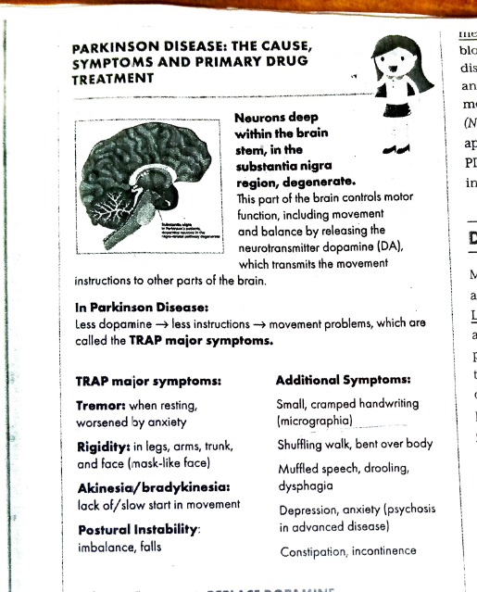

Slide 10
Types (1)
1.Idiopathic Parkinson's disease --Most common type.
Causes are not known,
Main symptoms
Tremors,
Rigidity and
Slowness of movement.

Slide 11
Types (2)
2.Vascular Parkinsonism: --atypical forms of parkinsonism.
•Likely causes
Hypertension and Diabetes.
A stroke (cerebrovascular accident),
Cardiac disease or carotid artery pathology (another form of stroke).
•Symptoms -Difficulty speaking, making facial expressions or swallowing.
•Others - Problems with memory or confused thought, cognitive problems and incontinence.

Slide 12
Types(3)
3.Inherited Parkinson's- Not directly inherited, some people (5% of people) may have genes that increase the possibility of developing Parkinson's particularly when combined with other factors, such as environmental toxins or viruses.
4.Drug Induced Parkinsonism:
•Antipsychotics: Chlorpromazine, Fluphenazine and Haloperidol
•Antihypertensive like Reserpine
•Antiemetics: Metochlopramide (Reglan) and Prochlorperazine (Compazine),
•Most people will recover within months, and often within hours or days, of stopping the drug that caused the dopamine block.
•Not associated with loss of nerve cells in the substantia nigra

Slide 13
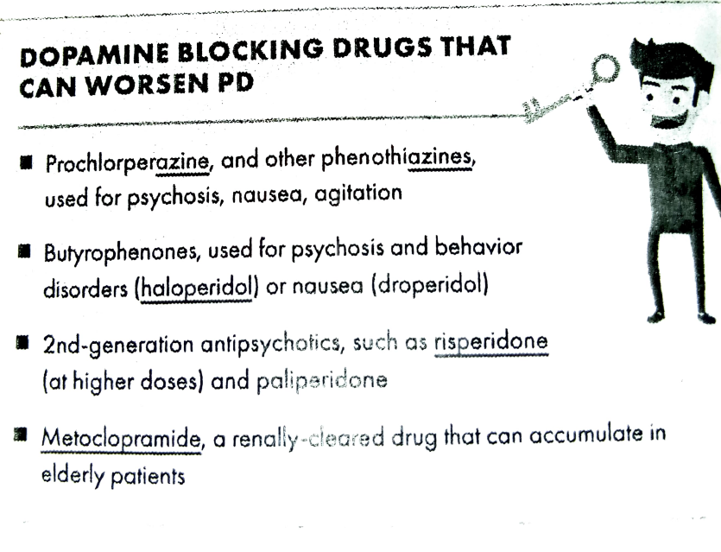

Slide 14
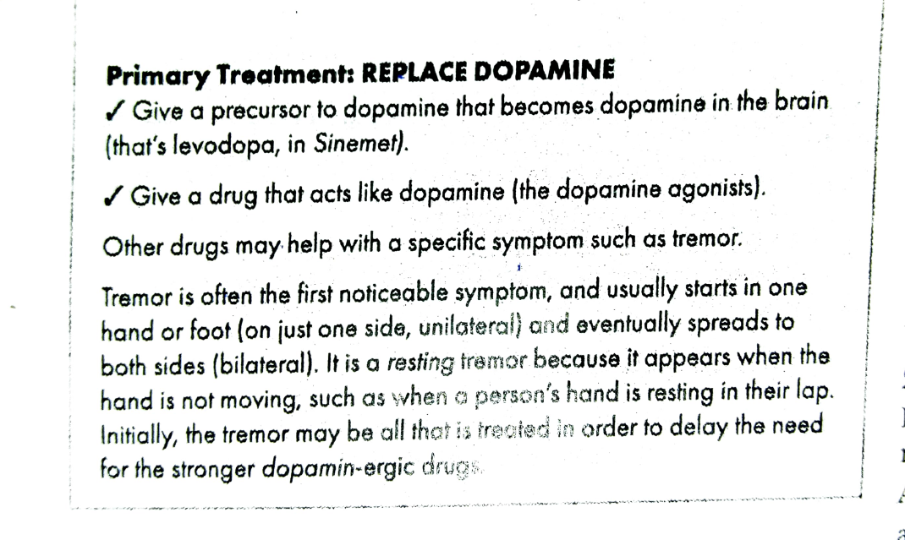

Slide 15
Classification of antiparkinsonian Drugs:
Drugs acting on dopaminergic system:
–Dopamine precursors – Levodopa (l-dopa)
–Peripheral decarboxylase inhibitors – carbidopa and benserazide
–MAO-B inhibitors – Selegiline, Rasagiline
–COMT inhibitors – Entacapone, Tolcapone
–Dopaminergic agonists: Bromocriptyne, Ropinirole and Pramipexole
–Dopamine facilitator - Amantadine
•Drugs acting on cholinergic system
–Central anticholinergics – Trihexyphenidyl (Benzhexol), Procyclidine, Biperiden
–Antihistaminics – Orphenadrine, Promethazine

Slide 16
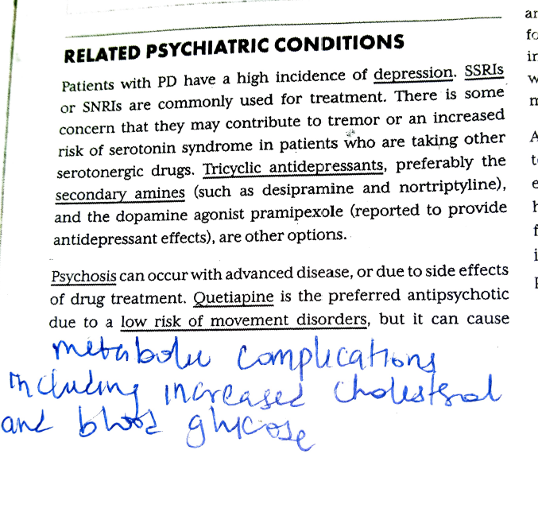

Slide 17
The net result of all of these medications is the balancing out of the acetylcholine/dopamine balance and an improvement in movement

Slide 18
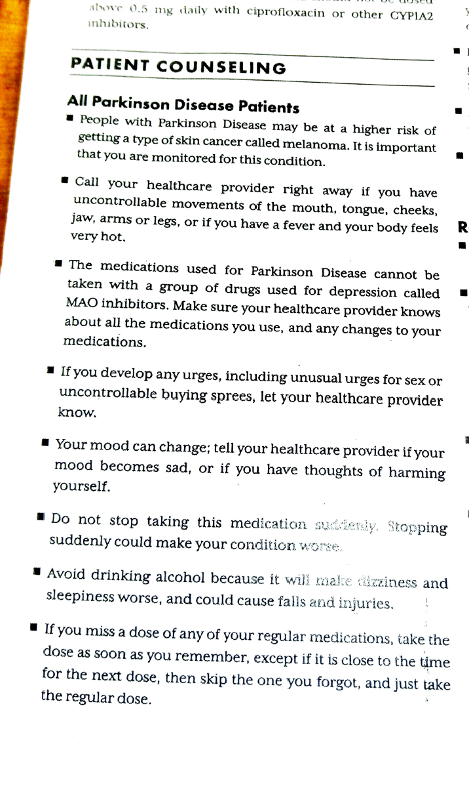

Slide 19
Patient Counseling 2

Slide 20
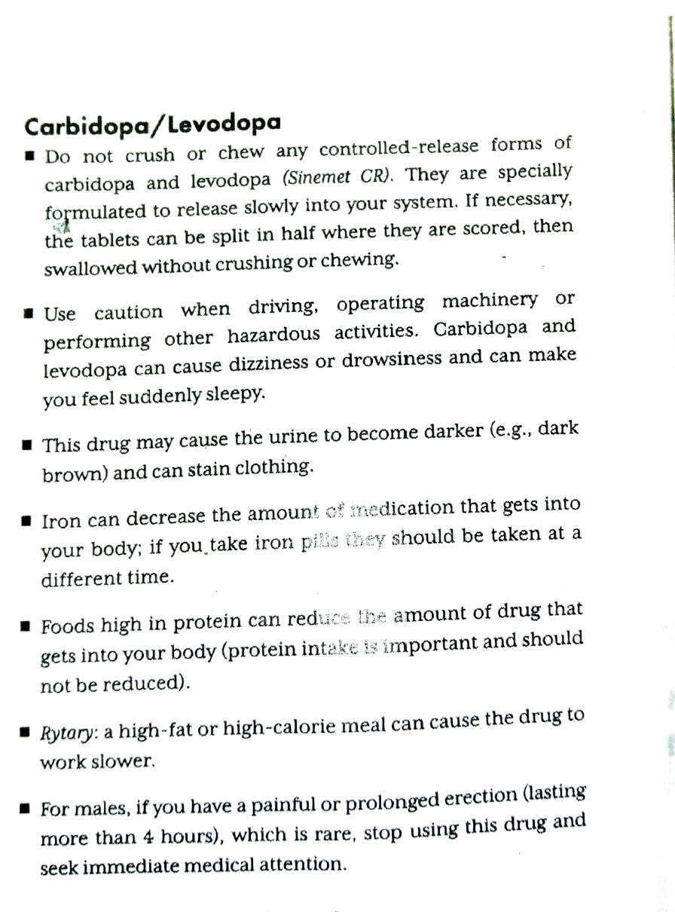

Slide 21
Carbidopa/Levodopa

Slide 22
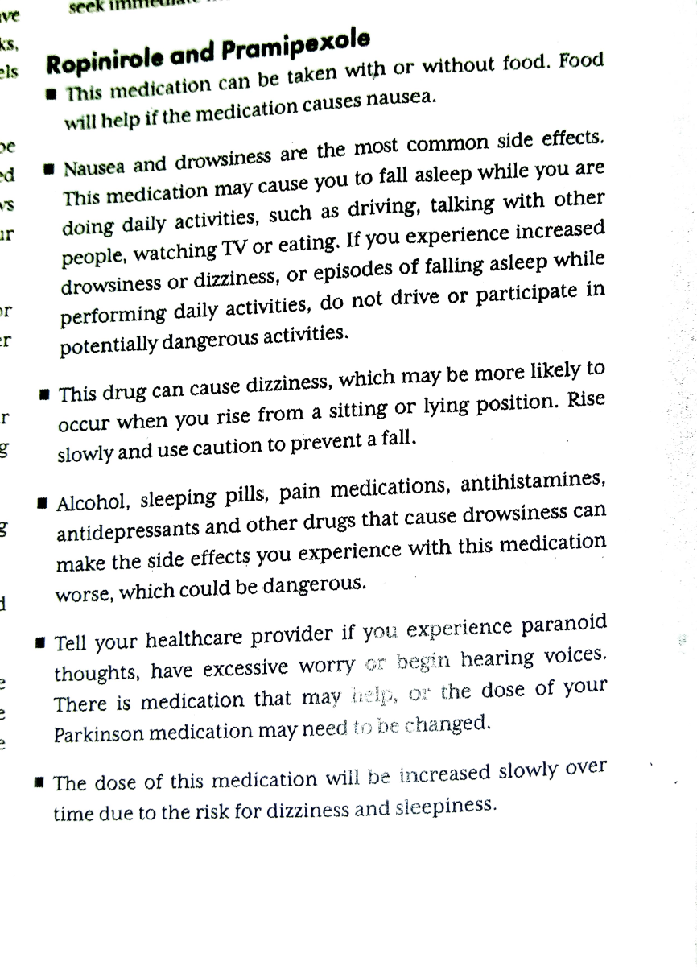

Slide 23
Ropinirole and Pramiprexole (contd.

Slide 24
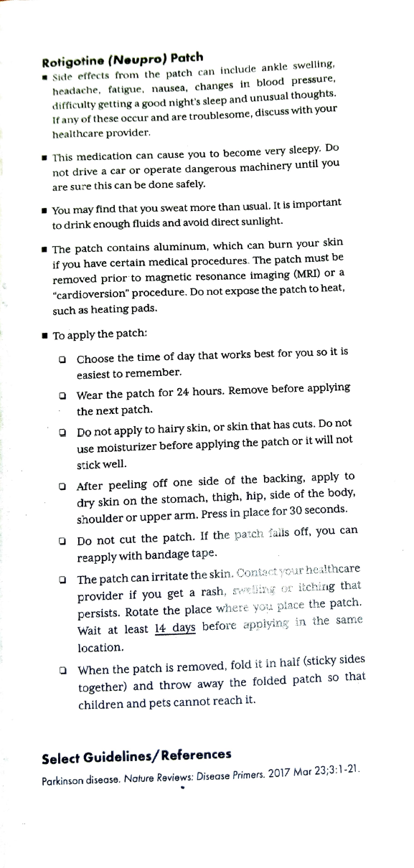

Slide 27
2. Hypno-Sedative Drugs

Slide 28
Definitions
Anxiolytic- A drug which reduces anxiety and causes calm and quietness in the patient
Sedative- A drug that reduces activity and calms the patient.
Hypnotics- A drug that causes drowsiness and facilitates the onset and maintenance of a state of sleep that resembles natural sleep.

Slide 29
Definitions
Anxiety ------ Drowsiness------- Sleep ---- Anesthesia -----Coma ----
Death.
Difference between Sedatives and hypnotics = The dose
Lower Dose -Calming Effect
Higher Dose – Causes Sleep
Some newer medicines have separated the effects.
E.g Buspirone- An anxiolytic without causing sedation

Slide 30
Anxiety
A normal adaptive response
It is a disorder if
-Its Chronic
-Disproportionate to the situation
Interferes with a persons concentration and ability to do routine task

Slide 31
Anxiolytics /Hypnotives /Sedatives
Benzodiazepines
Z Compounds' e.g Zoldipem
Barbiturates e.g Phenobarbital
Choral Hydrate
Buspirone
Melatonin Congeners e.g Ramelteons

Slide 32
USES
Insomnia – induce sleep
Anxiety: panic disorders, phobias, agitated psychosis
Convulsions, seizures
Muscle relaxant, relieve spasms
Pre surgical operations, sedation for minor surgical procedures (twilight - amnestic)
Sedation/anticonvulsant for alcohol withdrawal

Slide 33
Anti-Anxiety & Hypnotics
Anti-Anxiety---Benzodiazepine e.g. Diazepam
Non Benzodiazepine e.g. Buspirone
Hypnotics: Sedatives
Benzodiazepine e.g. Temazepam
Non Benzodiazepine e.g. Zopiclone

Slide 34
Antidepressants for anxiety
 | DRUG | use
(TCA) Tricyclic Antidepressants | Clomipramine (Anafranil, Clopram, Placil) | OCD
Selective Serotonin Reuptake Inhibitor (SSR I) | Fluvoxamine( Faverin, Luvox) | OCD
(SSRI) | Paroxetine (Aropax, Oxetine, Paxtine) | OCD, panic disorder, social phobia
(SSRI) | Fluoxetine (Auscap, Fluohexal, Lovan, Prozac, Zactin) | OCD
(SSRI) | Sertraline (Zoloft) | OCD, panic dis, PTSD
(SNRI) | Venlafaxine (Efexor) | GAD

Slide 35
Benzodiazepines(1)
It is the portion of a structure composed of a the benzene ring (A) and diazipine Ring (B)
MODE OF ACTION Benzodiazepines binds to GABAa receptors ---

Slide 36
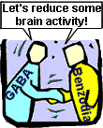
Benzodiazepines: Action
CNS depressant
Enhance the effect of GABA.
GABA is a neurotransmitter that inhibits neuronal activity i.e. reduces the firing rate of neurones.
Notes:
Potentiate other CNS depressants: Alcohol, anti-histamines, analgesics, anti-convulsants, anti-psychotics, hypnotics, barbiturates, anaesthetics.
Combination will lead to sedation and may lead to unconsciousness and death.

Slide 37
Pharmacological Actions
Reduction of anxiety and aggression
Induction of sleep
Anterograde amnesia
Anticonvulsant effect
Reduction of muscle tone and coordination
Effect on Respiration
Effect on CVS

Slide 38
Reduction of anxiety and aggression
ALL Benzodiazepines show anxiolytic effects
Causes Parabolic hyperexcitabilty – Talkativeness, aggressiveness and anti social acts

Slide 39
Induction of sleep
Reduces Sleep latency, Increases sleep time, Reduced number of awakenings after onset of sleep, Improve overall quality of sleep
Alters Sleep architecture (reduces rapid eye movement

Slide 40
Others
Anterograde amnesia
Performing minor surgeries without leaving unpleasant memories
Anticonvulsant effect in animal test. E,g Cloazepam antiepileptic effects, Diazepam in acute seizures)
Reduction of muscle tone and coordination by a central action on GABAa receptors on the spinal cord
Effect on CVS Decrease in blood pressure and increase in Heart Rate in preanasthetic doses.(Midazolam via reduced peripheral resistance ; Diazepam via negative ionotropic effect

Slide 41
Effect on Respiration
Decrease hypoxic respiratory drive and causes respiratory acidosis
Can only affect respiration in children and individuals with impaired hepatic function alcoholics
Need respiratory support in toxcity e.g if taken with another CNS depressant such as alcohol

Slide 42
Uses of Benzodiazepines
Used mostly in primary care rather than psychiatry.
Often prescribed for problems that are more effectively managed with non-drug therapies.
Temazepam in 10 most frequently prescribed up until 2001.
Should not be 1st line therapy in mental health & sleep management.
Limit use to less than 2 weeks.
Only benefit of continued use is avoiding withdrawal effects (NPS, 1999).
All equally effective but differ in metabolism, speed of onset & half life

Slide 43
Indications | Drug
Anxiolytic | Diazepam, Alprazolam, Bromazepam, Lorazepam, Oxazepam, Buspirone*
Muscle relaxant | Diazepam
Pre-med | Diazepam, Lorazepam
Alcohol withdrawal | Diazepam, Oxazepam,
Panic disorder | Alprazolam, Clonazepam.
Anti-convulsant | Clobazam, Clonazepam, Diazepam, Lorazepam
Hypnotic | Flunitrazepam, Nitrazepam Temazepam, Zolpidem, Zopiclone*
Notes:
* = Non benzodiazepine

Slide 44
Dose Equivalents
Drug | Daily range mg | Equiv 5mg diazepam. | Duration (½ life)
alprazolam | 1 – 4 | 0.5 - 1 | Short/Intermediate
bromazepam | 6 – 9 | 3 – 6 | Short/Intermediate
clobazam | 30 – 80 | 10 | Intermediate
clonazepam | 4 – 8 | 0.5 | Intermediate
diazepam | 5 – 20 | 5 | Long
flunitrazepam | 0.5 – 2 | 1 – 2 | Intermediate
lorazepam | 2 – 4 | 1 | Short/Intermediate
nitrazepam | 5 – 20 | 5 – 10 | Intermediate
oxazepam | 45 – 90 | 15 – 30 | Short
temazepam | 10 – 30 | 10 - 20 | Short
triazolam | 0.125 - 0.25 | 0.25 | Short
buspirone* | 15 – 30 | - | Short
zopiclone* | 3.75 - 7.5 | - | Short
Notes:
* Non benzodiazepine

Slide 45
Short Acting: 3 - 8 hrs
Oxazepam
Temazepam
Triazolam
Buspirone*
Zopiclone*
Notes:
Non benzodiazepine

Slide 46
Intermediate Acting: 10 - 20 hours
Alprazolam
Bromazepam
Clobazam
Clonazepam
Flunitrazepam
Lorazepam
Nitrazepam

Slide 47
Tolerance
A gradual escalation of dose is needed to produce the required effect
It occurs in hypnotic effects after 1-2 days of use
Also seen in muscle relaxants and anticonvulsants

Slide 48
Dependency cycle of benzodiazepines
Use of benzodiazepine
Even more anxious
Reduced anxiety
Effect wears off
Green, 1996, p. 88

Slide 49
Dependence -Psychological and Physical
Psychological Dependence –
Drug craving that can lead to drug seeking behavior
Physical Dependence –
When drug is stopped and withdrawal symptoms set in

Slide 50
Withdrawal Symptoms
Abrupt cessation: > seizures
Occurs between doses during continuous use (inter-dose withdrawal). Patients may think these symptoms are due to the original problem.
experienced by 45% of patients discontinuing low dose benzodiazepines & 100% patients on high doses.
Short half life benzodiazepines are associated with more acute & intense withdrawal symptoms.
Long half life benzodiazepines - milder, more delayed withdrawal

Slide 51
Withdrawal Symptoms
Mimics symptoms of anxiety disorders
Increased Anxiety
Insomnia (sleep disorder), anorexia
Muscle Twitching Tremor, Perspiration
Unsteadiness, Nervousness & nausea
Hypersensitivity to light and noise
Convulsion , Delirium Tremens, Aching limbs

Slide 52
To Withdraw from Benzodiazepines
Benzodiazepines should not be ceased abruptly.
Dose reduced by 10-20% per week.
Patient allowed to stabilise between each reduction.
Admission for high dose users, history of seizures or psychosis, or for more rapid withdrawal.
Implement relaxation/cognitive techniques.
If necessary referral: Drug & Alcohol Services; Self Help group; Psychologist

Slide 53
Contra-indications
Myasthenia gravis.
Severe respiratory impairment e.g sleep apnoea, COAD.

Slide 54

Avoid (if possible)
Pregnancy
Lactation

Slide 55
Adverse Effects
Physical dependence occurs in about 1 in 3 patients.
History substance abuse > risk dependence
Increased accident risk.
Tolerance & rebound insomnia.
Alcohol & CNS depressants potentiate adverse effects.
60y+ > vulnerability to confusion, memory impairment, over sedation (most common S/E) & falls.
Adverse mood effects: depression, emotional anaesthesia, aggression, increased suicide risk in elderly.

Slide 56
Overdose Benzodiazepines
Generally safe in overdose unless mixed with alcohol/CNS depressants.
Symptoms overdose: hypotension, respiratory depression & coma.
Treatment: Supportive
Flumazenil rarely indicated

Slide 57
IV Flumazenil
Dangerous to use if mixed overdose (e.g benzodiazepine + tricyclics, amphetamines, other pro-convulsants) - Result in uncontrolled seizure
Flumazenil has a shorter half life ( one hour) than all benzodiazepines Therefore, repeat doses of flumazenil may be required to prevent recurrent symptoms of overdosage once the initial dose of flumazenil wears off.

Slide 58
Non benzodiazepines Anxiolytic: Buspirone (Buspar)
Different action to bzd. ; Not a CNS depressant.
Partial agonist (stimulant) of dopaminergic & serotoninergic receptors.
No sedation, anti-convulsant or muscle relaxant properties - just anxiolytic.
Delayed action (1-2 weeks)
Effect reduced if benzodiazepine used in last 3/12

Slide 59
Comparison of benzodiazepine & buspirone
Benzodiazepine
Rapid onset
Can cause sedation
May impair performance
Additive effects with alcohol
May cause dependence & withdrawal
Pharmacokinetic change with age
Associated with falls in elderly (Keltner & Folks, 2001)
Buspirone
Delayed onset (cannot be used PRN)
Does not cause sedation
Does not impair performance
No additive effect with alcohol
Non addictive
No pharmacokinetic change with age
Does not cause falls in elderly
Expensive (Not on PBS)
Notes:
Gradual improvement in 1 to 2 weeks, maximum effect in 4 to 6 weeks

Slide 60
Z Compounds
Examples- Zolpidem, Zopiclone
Structurally unrelated to benzodiazepines
Acts as agonist of benzodiazepine site of GABAa receptor
Little effect o the stages of sleep
Tolerance and physical dependence -rare

